Slide 1
The New Advancement Party
Period 4
December 20, 2016

Slide 2
The New Advancement Party
“There’s always room for Advancement.”

Slide 3
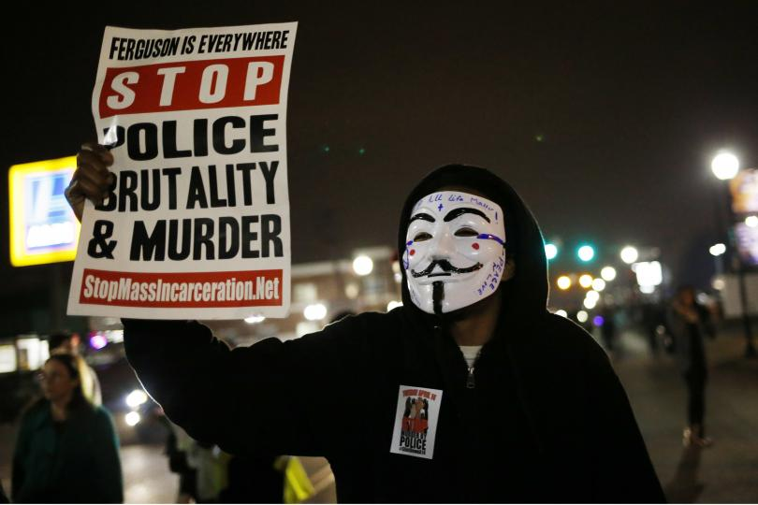
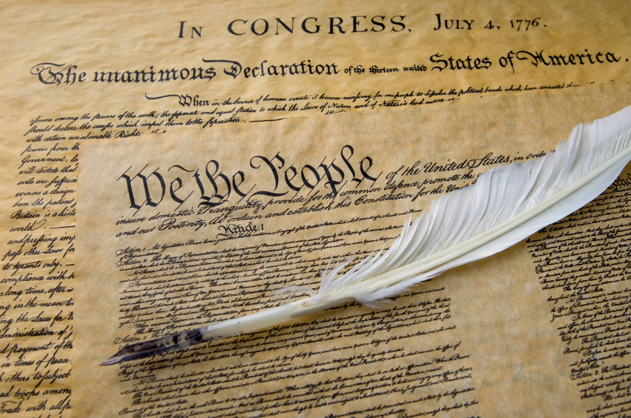
Our Mission Statement
Our mission is to create advancements in problems that are seen as overlooked and to secure those rights that are continuously violated by the law enforcement.
We plan to uphold the beliefs and principles of the Declaration of Independence and the Constitution.
We visualize a world where people can freely exercise their innate rights without the fear of being taken down by anyone.
There is always room for advancement in the world

Slide 4
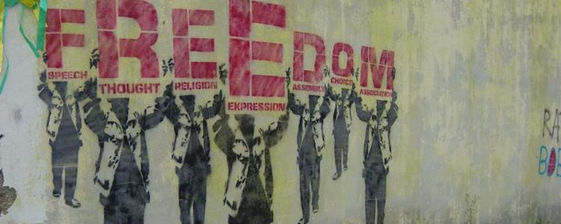
Personal Freedom
Everyday there’s people all over the world being violated of their personal and civil rights. Businesses are being sexist to women, police use race to decide what person to stop, arrest, or even murder, racism is everywhere, and many other right violations are happening as we speak. The New Advancement Party plans to assess these right violations by making advancements in rules and regulations anywhere that people feel are being violated. We support equality for all because they’re human. And these are basic human rights that are being violated. There is a major need for respect within the human race without people thinking they’re superior than the rest.

Slide 5
Healthcare
There are many things going wrong with general healthcare. Getting medical care is expensive as well as health insurance, health insurance only covers a number of things, malpractice is increasing in clinics and hospitals, waiting for care is taking too long, and sometimes the amount of care received isn’t enough to help the patient. The New Advancement party stands for a reform in healthcare where health insurance is made more affordable for people, waiting time is cut, the quality of care in specific facilities is increased, and malpractice is avoided as much as possible. This can cause an advancement in healthcare.

Slide 6
Education
Over the years, education has changed for both the better and worst. These changes have taken its toll on today’s students and teachers. Teachers are underpaid for the amount of work they put into their classroom and for their supplies and the new and rapid change in their district curriculum is taking a toll on them. Some teachers don’t even like teaching which takes a toll on student learning. Students aren’t receiving the same education as students of past years a certain aspects of schools are making students struggle. The New Advancement Party supports the backing down of the Common Core standards, lessen the dependence of technology in school, and provide pre-service teaching programs to see if upcoming teachers actually like the career.

Slide 7
Corruption
Corruption is the leading problem around the world that is the cause of many other problems. Corruption is both a major cause and a result of poverty in countries. It’s found everywhere. In the government, in businesses, in law enforcement, and within society itself. The New Advancement Party supports anti-corruption measures and corruption punishment. Transparency of, and access to information is something we believe will reduce corruption in business and government spending and funding. Keeping people at a local, national, international, and global levels will help to scope out corruption before it gets too out of hand. The more the people speak out about corruption, the more will be heard.

Slide 8
Sexual Harassment Crimes
Sexual harassment crimes are very overlooked in today’s society and law enforcement. In society, rape and sexual assault are often blamed on the victim and her image when she’s surrounded by possible predators instead of blaming the predator for having the audacity to violate someone. In the law enforcement, crime time for rape and sexual assault aren’t enforced like it should be. For these reasons, victims of sec crimes don’t bother to report these crimes. The New Advancement Party stands for adequate punishment for sex crimes no matter the age, gender, and race. We encourage victims to speak up and report the crimes before it’s too late. These crimes should not be overlooked.

Slide 9
Gun Control and Violence
As stated in the Constitution, everyone is entitled to own a gun. That doesn’t mean there’s proper restrictions to owning a gun. Guns kill about 30,000 people and cause about 60,000 injuries a year in the US. The issues on gun violence have only increased tensions between political parties (Democratic and Republican) as more massacres have claimed the lives of Americans, that’s why my political party has the solution to minimize this problem. The new Advancement party proposes safe and strict guidelines for gun sellers to follow and logic exams gun carriers must pass in order to ensure the safely of others.

Slide 10
Why the New Advancement Party?
New Advancement Party | Issues | Republican Party
Stricter gun law | Massacres throughout US becoming more often | Less Gun Laws
Immigration Reforms | Undocumented people cant work legally or got to school | Deport Immigrants
New Affordable healthcare | Many people cant afford healthcare. | Defund Obama Care.

Slide 11
Opinion Poll
Issue | Strongly Agree | Agree | Disagree | Strongly Disagree
Violation of Personal Freedoms | 13.6% | 54.4% | 9.1% | 22.7%
Healthcare | 36.4% | 40.9% | 18.2% | 4.5%
Education | 45.5% | 36.4% | 13.6% | 4.5%
Corruption | 36.4% | 27.3% | 27.3% | 9.1%
Sexual Harassment | 63.6% | 18.2% | 13.6% | 4.5%
Gun Control | 22.7% | 18.2% | 40.9% | 18.2%
Poll Link: https://goo.gl/forms/eAaEw3zH33HaSPct2

Slide 12
Campaign advertising

Slide 13
Work Cited
"Background of the Issue - Gun Control - ProCon.org." ProConorg Headlines. N.p., n.d. Web
DeWitt, Peter. "10 Critical Issues Facing Education." Education Week - Finding Common Ground. N.p., 02 May 2016. Web. "Here Are 10 Ways to Fight Corruption." Governance for Development. N.p., n.d. Web.
Issues2000.org. "Political Leaders' Views on the Issues." Political Leaders' Views on the Issues. N.p., n.d. Web.
Miller, Jake. "Issue Brief: Health Care." CBS News. CBS Interactive, 01 Oct. 2012. Web.

