Slide 1
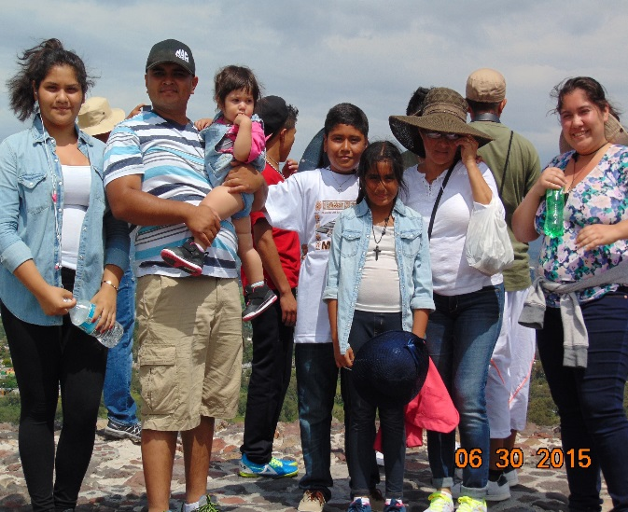
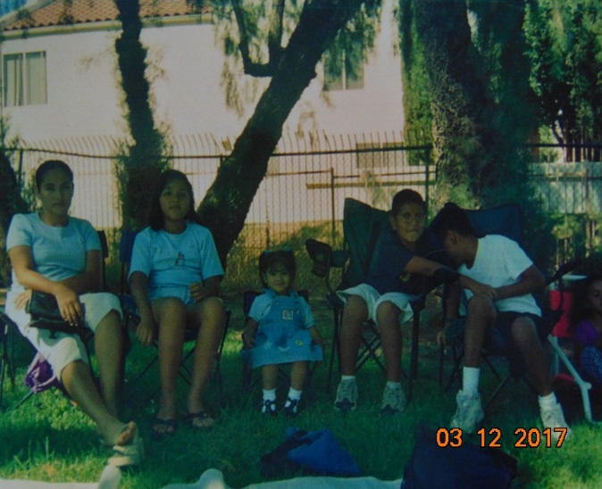
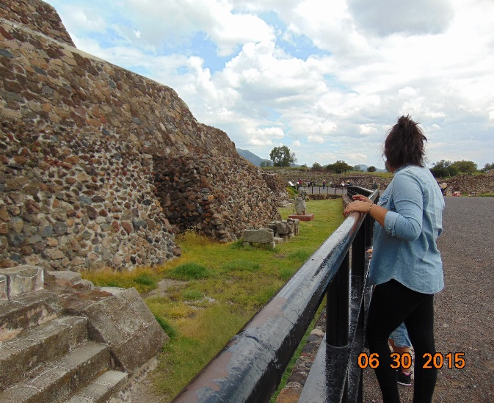
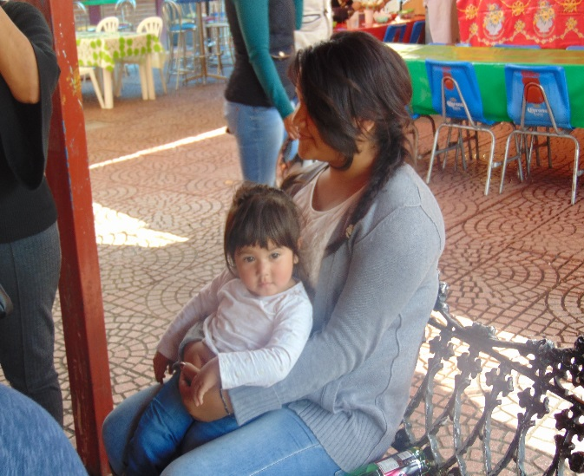
Melanie Pena

Slide 2
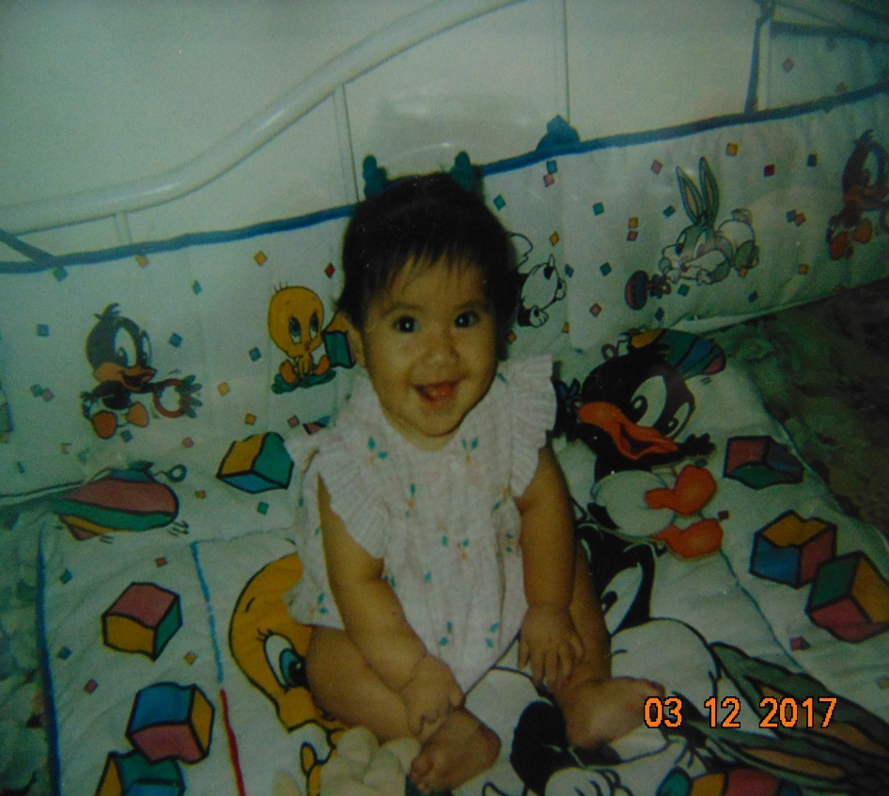
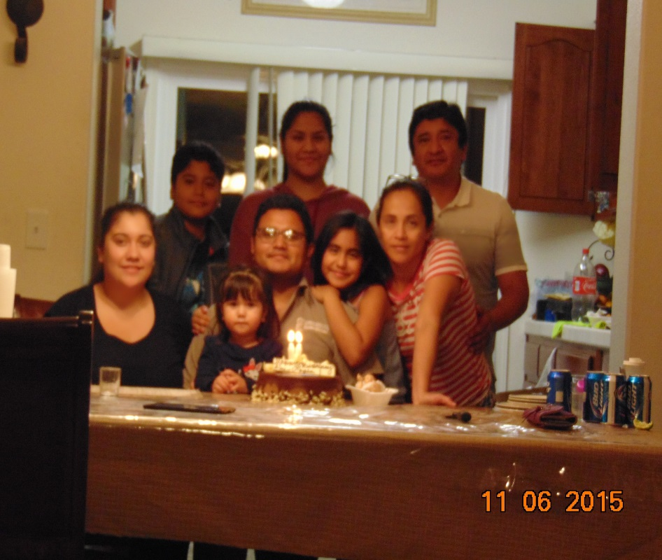
About Me
Born Jan. 26, 1999 in Van Nuys California
Come from a Mexican American family of 6
Parents, 1older and 2 younger siblings
Moved to Lindsay at age 15
Special Skill: have a strong sense of helping others
Personal Challenge: moving to Lindsay during high school

Slide 3
High School Experience
Moved to LHS sophomore year
Clubs: FBLA, Spanish Honors, Key Club, NATP, Drama Club Secretary, Adventure Club, PGLA, Puente, Dance
PBS System was different
Faced lots of challenges in school and at home that tested me
Finally got my first report card with straight 4’s
Learned: I need to work for my own things

Slide 4
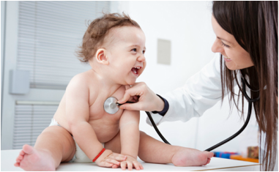
Job Shadow
Job shadowed Dr. Grace Hwang in Porterville.
I want to become a Family Physician in the future
Interesting/shocking: never overbooked, got to her patients quick, had a connection with all her patients
Memorable: the two patients I got to see with her, all the lovable kids, the advice she gave me
Career is definitely for me!

Slide 5
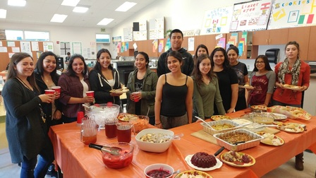
Pathway
Food Service and Hospitality.
3 courses on food prep and service
Relates to medicine by communicating with people
Taught me to: not be shy when it comes to helping someone, lead people, and work as a team

Slide 6
Post-High School Plans
Pursuing a 4-yr University
Accepted: CSU Channel Islands, San Francisco State, University of the Pacific, UC Merced
Waiting on: UC Irvine, UC Santa Barbara, CSU Fullerton, Washington State
Major: Biology
Backup Major: Child Development, Management and Business Econ.
Have very little family/financial support
Heavily relying on FAFSA and Grants
Goals
Short: graduate high school with a 3.5 or higher
Long: become a Family Physician in the central valley or join the Army

Slide 7
Leaving LHS
Reflecting on the years:
Many challenges
Changed as a person
PBS taught me:
The minimum isn’t always the best
Perseverance
Became self-driven

Slide 8
Any Questions?

