Slide 1
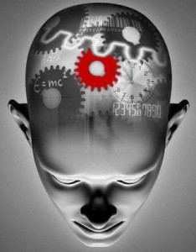
Cognitive Theory
Melanie Pena
Per. 1

Slide 2
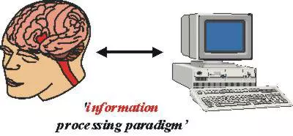
What Is Cognitive Psychology?
The study of the mental processes involved in acquiring knowledge.
Compares the way the brain processes information to the way a computer stores information
Ulric Neisser started cognitve psychology with the publication of “Cognitive Psychology” in 1967

Slide 3
Ulric Neisser
The Father of Cognitive Psychology
His main topics in cognitive psychology are Attention and Perception
By using research, Neisser
found out that the brain
concentrates on a small piece
of what's going on and ignores
the rest known as Inattentional
Blindness.
Specialized in Flashbulb Memory

Slide 4
Attention and Perception
Attention is the ability to concentrate on any of the perceived stimuli.
A young boy walking through the park and only notice a golden retriever or ice cream truck
Perception is the ability to make sense of the environment and surroundings.
A young boy walking through the park and noticing his surroundings like the slight breeze and the warmth of the sun
Both stem from the ability to consciously control and direct the mental process in connection to external stimuli
Ex: Physical stimuli, Visual stimuli, stored memory in connection to events

Slide 5
Inattentional Blindness
The failure to notice an unexpected object or event that your attention is focused on something else.
When attention is focused on a demanding task, you might not notice unexpected things entering your visual field
Visual attention experiment by Becklen and Cervone in 1983: https://www.youtube.com/watch?v=nkn3wRyb9Bk

Slide 6
Flashbulb Memory
Vivid, precise, long lasting memories of a personal circumstance.
Usually a person’s discovery of shocking events
Flashbulb memories are stored and kept for a lifetime. What makes it special is the emotion at the moment the event registered into the memory and increases the ability to recall the details of the event.
Ex: People remember exactly what they were doing when a shocking event occurred in their life.

Slide 7
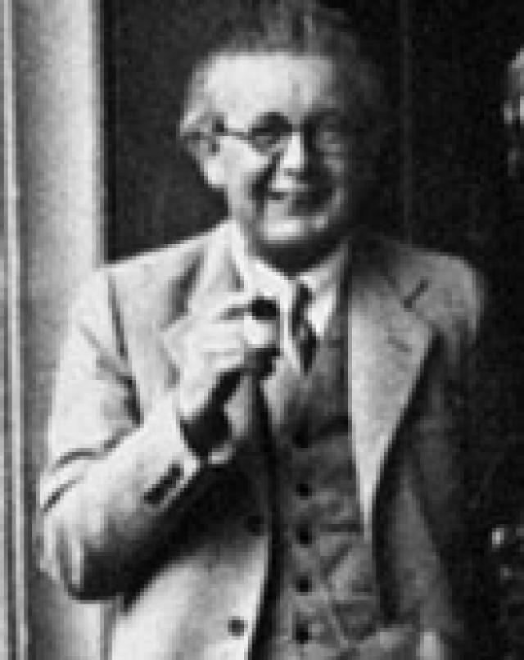
Jean Piaget
Is best know for his research on children’s cognitive development.
Studied the intellectual development of his children and came up with a theory on the stages of child mind development.
The Sensorimotor Stage
The Preoperational Stage
The Concrete Operational Stage
The Formal Operation Stage

Slide 8
The Sensorimotor Stage
The earliest stage in Piaget’s theory, from birth to age 2, and the period of tremendous growth and change.
During this stage, children get to know the world and gain knowledge through their senses and movements.
Can be divided into 6 separate substages:
Reflexes (0-1 month): Child understands the environment through inborn reflexes like sucking and looking.
Primary Circular Reactions (1-4 months): Involves coordinating sensations. Ex: a child can suck their thumb by accident and then intentionally repeat the action.
Secondary Circular Reactions (4-8 months): Child becomes more focused and begins to intentionally repeat actions in order to trigger a response. Ex: A child will purposely pick up a toy to put it in their mouth.
Coordination of Reactions (8-12 months): Child starts to show clear intentional actions, will explore their surroundings, imitate the behavior of others, and begin to understand objects. Ex: A child realizing that the rattle makes a sound when shaken.
Tertiary Circular Reactions (12-18 months): Children begin trial-and-error experiments. Ex: A child trying different sounds or actions to get attention from a care giver.
Early Representational Thought (18-24 months): Children develop symbols that represent objects in the world. They begin to move towards mentally understanding the world.

Slide 9
The Preoperational Stage
The Second stage in Piaget’s theory. Begins around age 2 and lasts until age 7.
Language development and role playing are the main characteristics of this period.
Piaget used Egocentrism and Conversation to demonstrate what abilities children have not yet developed.
Egocentrism: The fact that we can see things from only our perspective. Ex: When children were asked to choose a picture showing what someone else would see.
Conversation: The understanding that changing the form of a substance doesn’t change the overall volume or mass. Ex: Equal amount of liquid is poured into two identical containers then poured into two different shaped container. The children are asked to choose which container has more water.

Slide 10
The Concrete Operational Stage
The third stage in Piaget’s theory that begins around age 7 until age 11.
Its characterized as the development of logical thought and the gaining of better understanding of mental operations.
Logic: Children in this stage were good at the use of inductive reasoning like going from a specific experience to a general principle.
Ex: Having itchy eyes, runny nose, and a swollen throat every time your near a cat leads you to being allergic to cats.
Reversibility: The awareness that actions can be reversed and being able to reverse the order of relationships between mental categories.
Ex: A child recognizing that their dog is a Labrador, that a Labrador is a dog, and that a dog is an animal.
Conversation and Egocentrism disappear in this stage.

Slide 11
The Formal Operation Stage
The fourth and final stage in Piaget’s theory. It begins at age 12 and lasts into adulthood.
During this period, people develop the ability to think about ideal concepts
Logical thought, reasoning, and systematic planning also appear during this stage.

Slide 12
How Cognitive Psychology is Used Today
Cognitive development is used widely in school systems and in the development of curriculums for children.
Used to predict what a child can or cannot understand depending on their stage of development.
Programs like Anchored Instruction, Microwords, and Symbol Pads have been developed for children using cognitive theory. 1

Slide 13
Work Cited
Cherry, K. (n.d.). Concrete Operational Stage of Cognitive Development. Retrieved September 15, 2015, from http://psychology.about.com/od/piagetstheory/p/concreteop.htm
Cherry, K. (2005). Jean Piaget Biography. Retrieved September 15, 2015, from http://psychology.about.com/od/profilesofmajorthinkers/p/piaget.htm
Cherry, K. (n.d.). Preoperational Stage of Cognitive Development. Retrieved September 16, 2015, from http://psychology.about.com/od/piagetstheory/p/preoperational.htm
Cherry, K. (n.d.). Sensorimotor Stage of Cognitive Development. Retrieved September 16, 2015, from http://psychology.about.com/od/piagetstheory/p/sensorimotor.htm
Cherry, K. (n.d.). The Formal Operational Stage of Cognitive Development. Retrieved September 17, 2015, from http://psychology.about.com/od/piagetstheory/p/formaloperation.htm
Ejim, E. (n.d.). What Is the Connection between Perception and Attention? Retrieved September 17, 2015, from http://www.wisegeekhealth.com/what-is-the-connection-between-perception-and-attention.htm
Flashbulb Memory. (n.d.). Retrieved September 17, 2015, from http://www.uic.edu/classes/comm/comm200am/teamprojects/MemoryTechnologies/Flashbulb_Memory.htm
Ulric Neisser and Cognitive Psychology: Overview. (2003). Retrieved September 17, 2015, from http://study.com/academy/lesson/ulric-neisser-and-cognitive-psychology-lesson-quiz.html

